Slide 1
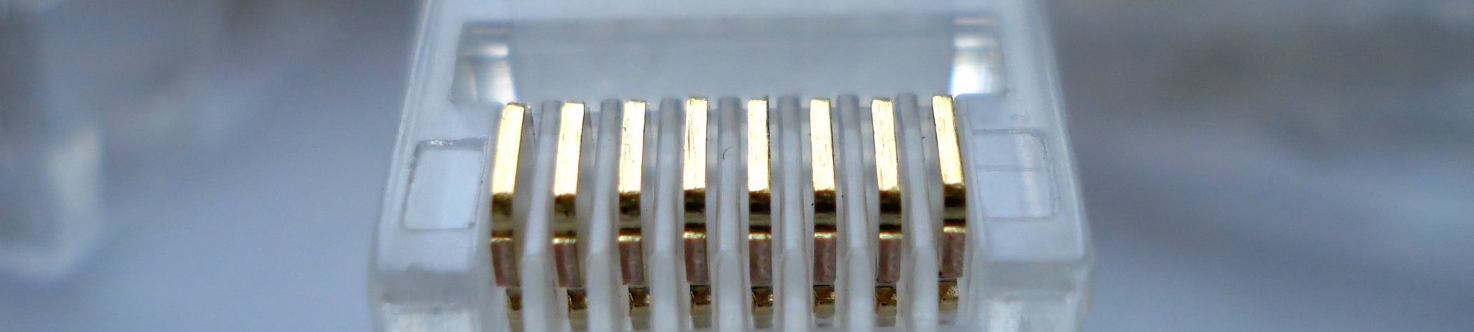
Chapter 1: Introduction to Software Engineering
Chapter 1 in Software Engineering Book

Slide 2
Overview
Learning Objectives.
What is software engineering?
Why is software engineering important?

Slide 3
By the end of this chapter, you will...
Understand what software engineering is.
Understand why software engineering is important.
Know answers to key questions related to the software engineering discipline.

Slide 4
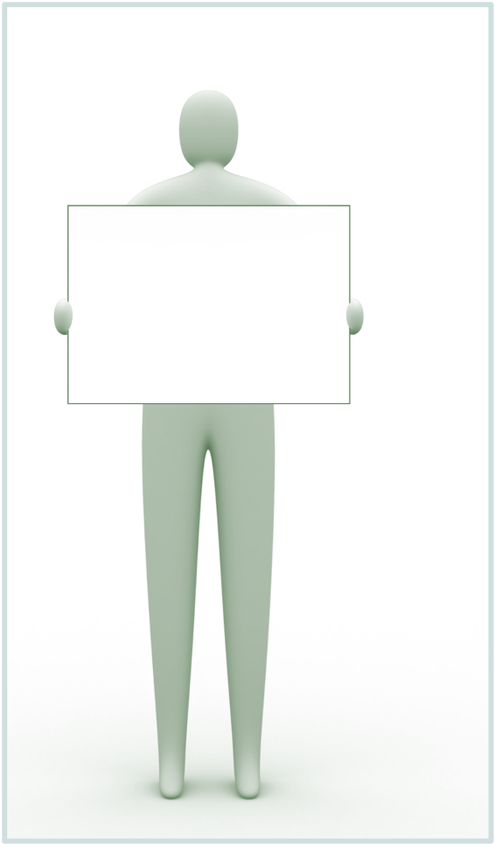
Activity
Think about all the devices and systems that you encounter in your everyday life which have software controlling them…
List as many as you can
Virtually all countries depend on complex computer-based systems.

Slide 5
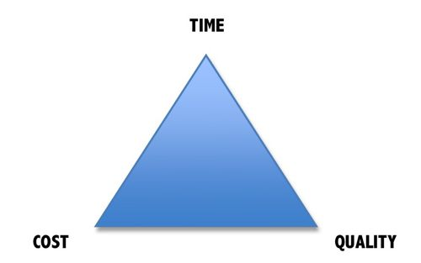
Why is Software Engineering important?
Complex systems need a disciplined approach for designing, developing and managing them.

Slide 6
Software Development Crises
Projects were:
  Late.
  Over budget.
  Unreliable.
  Difficult to maintain.
  Performed poorly.

Slide 7
Software errors….the cost
Errors in computer software can have devastating effects.

Slide 8

Software Crisis
  Example 1: 2009,Computer glitch delays flights
Saturday 3rd October 2009-London, England (CNN)
Dozens of flights from the UK were delayed Saturday after a glitch in an air traffic control system in Scotland, but the problem was fixed a few hours later.
The agency said it reverted to backup equipment as engineering worked on the system.
The problem did not create a safety issue but could cause delays in flights.
Read more at:
http://edition.cnn.com/2009/WORLD/europe/10/03/uk.flights.delayed

Slide 9
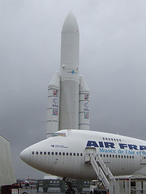
Software Crisis
  Example 2: Ariane 5 Explosion
  European Space Agency spent 10 years and $7 billion to produce Ariane 5.
  Crash after 36.7 seconds.
  Caused by an overflow error. Trying to store a 64-bit number into a 16-bit space.
  Watch the video: http://www.youtube.com/watch?v=z-r9cYp3tTE

Slide 10
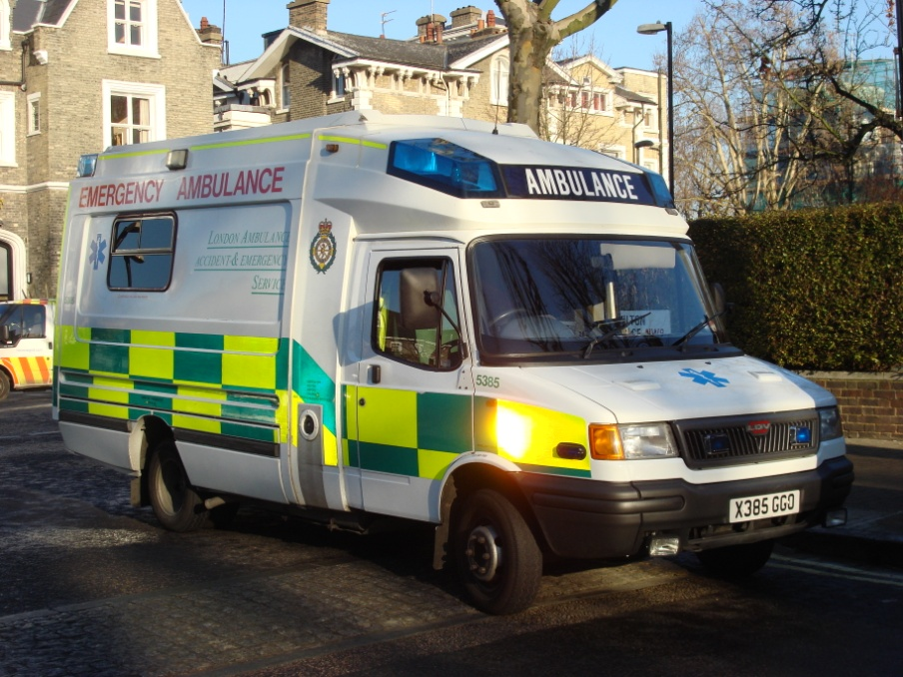
Software Crisis
  Example 3: 1992, London Ambulance Service
  Considered the largest ambulance service in the world.
  Overloaded problem.
  It was unable to keep track of the ambulances and their statuses. Sending multiple units to some locations and no units to other locations.
  Generates many exceptions messages.
  46 deaths.

Slide 11
Therefore…
A well-disciplined approach to software development and management is necessary. This is called engineering.

Slide 12
Software Engineering
The term software engineering first appeared in the 1968 NATO Software Engineering Conference and was meant to provoke thought regarding what was then called the “software crisis”..
“.. An engineering discipline that is concerned with all aspects of software production from the early stages of system specification to maintaining the system after it has gone into use.” Sommerville, pg.7

Slide 13
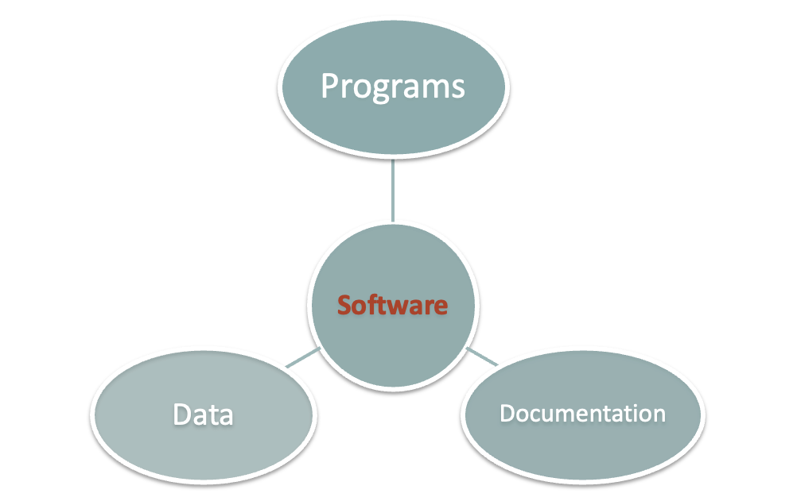
What is Software?
System Documentation
User Documentation

Slide 14
Types of Software
Generic products.
  Stand-alone systems that are marketed and sold to any customer who wishes to buy them.
  Examples – PC software such as graphics programs, project management tools; CAD software; software for specific markets such as appointments systems for dentists.
  The specification of what the software should do is owned by the software developer and decisions on software change are made by the developer.
Customized or bespoke products.
  Software that is commissioned by a specific customer to meet their own needs.
  Examples – embedded control systems, air traffic control software, traffic monitoring systems.
  The specification of what the software should do is owned by the customer for the software and they make decisions on software changes that are required.

Slide 15

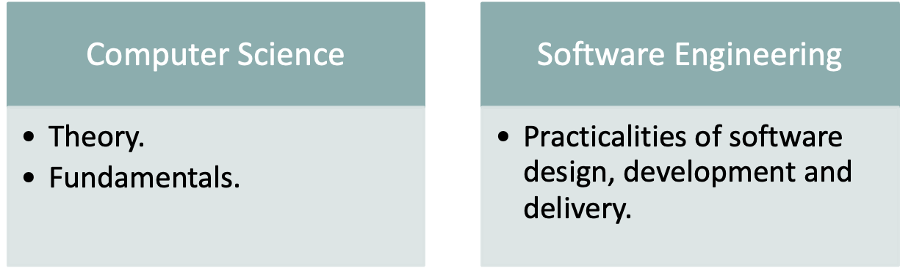
Software Engineering vs. Computer Science
“Computer science is no more about computers than
astronomy is about telescopes.” Edsger Dijkstra

Slide 16
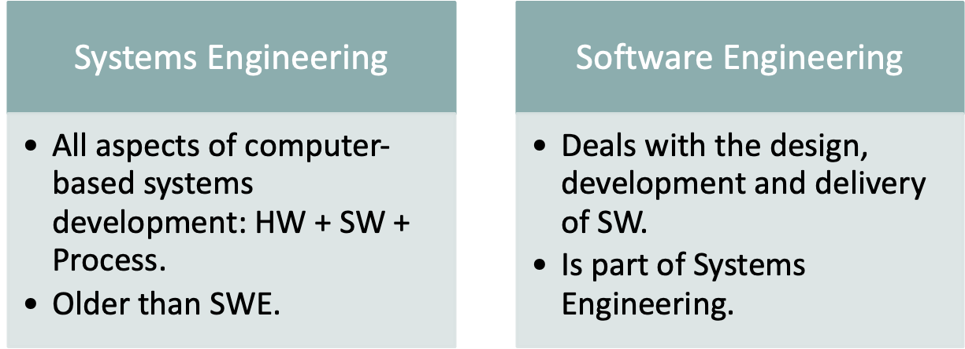
Software Engineering vs. Systems Engineering
Systems Engineering:
Interdisciplinary engineering field (computer, software, and process eng.).
Focuses on how complex engineering projects should be designed and managed.

Slide 17
Frequently asked questions about software engineering
Question | Answer
What is software? | Computer programs and associated documentation. Software products may be developed for a particular customer or may be developed for a general market.
What are the attributes of good software? | Good software should deliver the required functionality and performance to the user and should be maintainable, dependable and usable.
What is software engineering? | Software engineering is an engineering discipline that is concerned with all aspects of software production.
What are the fundamental software engineering activities? | Software specification, software development, software validation and software evolution.
What is the difference between software engineering and computer science? | Computer science focuses on theory and fundamentals; software engineering is concerned with the practicalities of developing and delivering useful software.
What is the difference between software engineering and system engineering? | System engineering is concerned with all aspects of computer-based systems development including hardware, software and process engineering. Software engineering is part of this more general process.

Slide 18
Frequently asked questions about software engineering
Question | Answer
What are the key challenges facing software engineering? | Coping with increasing diversity, demands for reduced delivery times and developing trustworthy software.
What are the costs of software engineering? | Roughly 60% of software costs are development costs, 40% are testing costs. For custom software, evolution costs often exceed development costs.
What are the best software engineering techniques and methods? | While all software projects have to be professionally managed and developed, different techniques are appropriate for different types of system. For example, games should always be developed using a series of prototypes whereas safety critical control systems require a complete and analyzable specification to be developed. You can’t, therefore, say that one method is better than another.
What differences has the web made to software engineering? | The web has led to the availability of software services and the possibility of developing highly distributed service-based systems. Web-based systems development has led to important advances in programming languages and software reuse.

Slide 19
What is a Software Process?
Activities and results that produce a software product:
SW Process Activity | What is going on there?
Specification | What does the customer need? What are the constraints?
Development | Design & programming.
Validation | Checking whether it meets requirements.
Evolution | Modifications (e.g. customer/market).

Slide 20
What is a Software Process Model?
Description of the software process that represents one view, such as the activities, data or roles of people involved.
Examples of views | Focus on…
Workflow | Activities = human actions. What is input, output, and dependencies.
Dataflow | Activities = transformations of information. How the input is transformed into output.
Role/Action | What is the role of people involved in each step of the process?

Slide 21
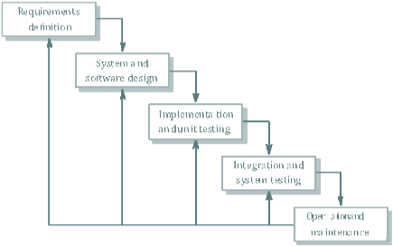
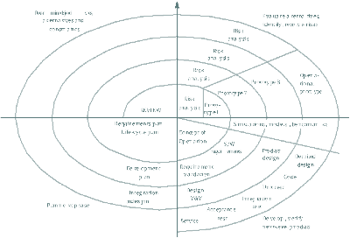
Some Software Process Models
Waterfall approach | Iterative development | Component-Based Software Engineering CBSE
 |  | assembled form existing components

Slide 22
The Cost of Software Engineering
Depends on:
  The process used, and
  The type of software being developed.
Each generic approach has a different profile of cost distribution.
Roughly 60% of costs are development costs, 40% are testing costs.
For custom software, evolution costs often exceed development costs.

Slide 23
Cost distribution
Custom software development (Bespoke)
Software Model
Cost units
Cost distribution
Software development activity
Waterfall Model
0 | 25 |  | 50 | 75 | 100
Specification |  | Design | Development | Integration and testing
Iterative Development
0 | 25 |  | 50 | 75 | 100
Specification |  | Iterative Development |  | System testing
Component-based Software Engineering
0 | 25 | 50 | 75 | 100
Specification | Development |  | Integration and testing
Development and evolution costs for long-lifetime systems
0 | 100 | 200 | 300 | 400
System development | System evolution

Slide 24
Cost distribution
Generic software development
0 |  |  | 25 |  | 50 |  |  | 75 | 100
Specification |  | Development |  | System testing
Product development costs

Slide 25
Attributes of good software
Functional attributes (performance; what the system does).
Non-functional attributes (quality; how the system does it).
Product Characteristic | Description
Maintainability | Evolution qualities such as Testability, extensibility.
Dependability | Reliability, security, safety.
Efficiency | Response time, processing time, memory utilization.
Usability | Easy to learn how to use the system by target users. Efficient to use the system by users to accomplish a task. Satisfying to use by intended users.

Slide 26
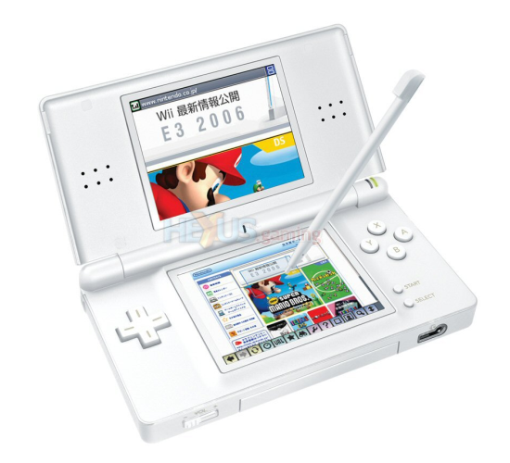


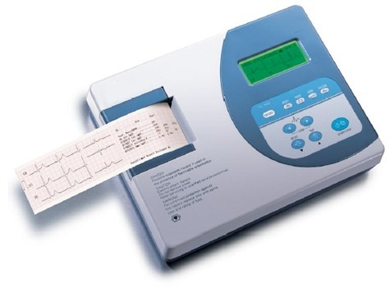



Activity
What are the key attributes for..
Interactive game | Banking system | Cardiac monitor in an ICU unit
Players, score, scenes, theme. | Client accounts, stocks bonds, money transfers. | heart rate, temperature, blood pressure.

Slide 27
Software Lifecycle Definition
Software lifecycle:
  Set of activities and their relationships to each other to support the development of a software system
Typical Lifecycle questions:
  Which activities should I select for the software project?
  What are the dependencies between activities?
  How should I schedule the activities?

Slide 28
Engineering Process Model
Specification: Set out the requirements and
constraints on the system.
Design: Produce a model of the system.
Manufacture: Build the system.
Test: Check the system meets the required
specifications.
Install: Deliver the system to the customer and
ensure it is operational.
Maintain: Repair faults in the system as they
are discovered.

Slide 29
Generic Software Process Models
Waterfall
  Separate and distinct phases of specification and development
Evolutionary
  Specification and development are interleaved
Formal Transformation
  A mathematical system model is formally transformed to an implementation
Reuse-based
  The system is assembled from existing components

Slide 30
1. The Waterfall Model
The waterfall model is the classic lifecycle
model – it is widely known, understood
and (commonly?) used.
In some respect, waterfall is the ”common
sense” approach.
Introduced by Royce 1970.

Slide 31
phase
output
User Requirements
User Requirements Document
Software Requirements
Software Requirements
Document
Architecture Design
Architectural Design
Document
”Swimming
upstream”
Detailed design & Coding
Detailed
Design
& Code
The Waterfall
Lifecycle Workflow
Testing
Delivery
Time

Slide 32
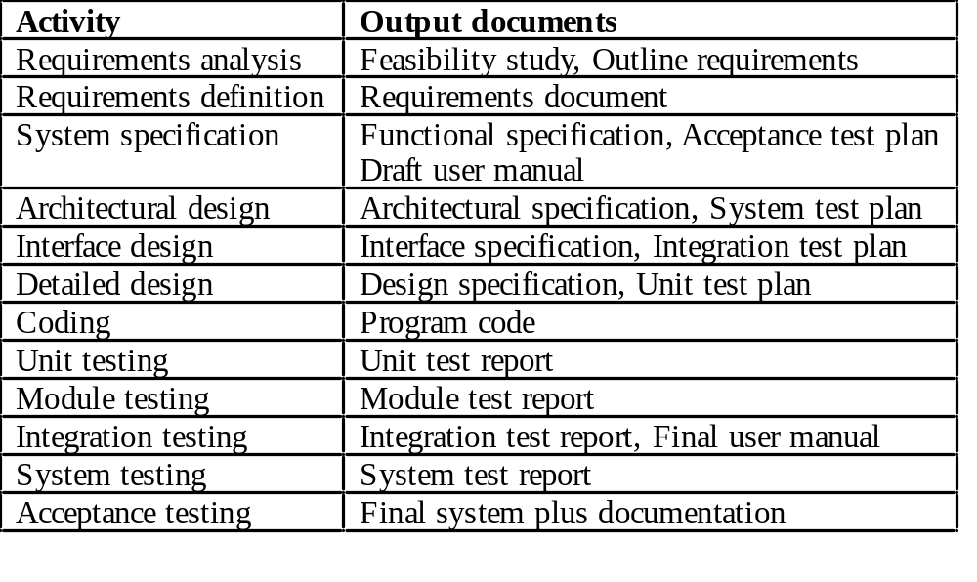
Waterfall Model Documents

Slide 33
Software Lifecycle Activities
Deliverable 0
Deliverable 1
Deliverable 2
Deliverable 3
Deliverable 4
Deliverable 5
Deliverable 6
Requirements
Elicitation
Requirements
Analysis
System
Design
Object
Design
Implemen-
tation
Testing
Implemented
By
Expressed in Terms Of
Structured By
Realized By
Verified
By
class...
class...
class...
?
class....
?
Use Case
Model
Application
Domain
Objects
Solution Domain
Objects
SubSystems
Source
Code
Test
Cases
Each activity produces one or more models

Slide 34
Advantages
Easy to understand and implement.
Widely used and known (in theory!)
Reinforces good habits: define-before- design, design-before-code
Identifies deliverables and milestones
Document driven, URD, SRD, … etc. Published documentation standards, e.g. PSS-05.
Works well on mature products and weak teams.

Slide 35
Disadvantages I
Idealised, doesn’t match reality well.
Doesn’t reflect iterative nature of exploratory development.
Unrealistic to expect accurate requirements so early in project
Software is delivered late in project, delays discovery of serious errors.

Slide 36
Disadvantages II
5. Difficult to integrate risk management
Difficult and expensive to make changes
to documents, ”swimming upstream”.
Significant administrative overhead,
costly for small teams and projects.

Slide 37
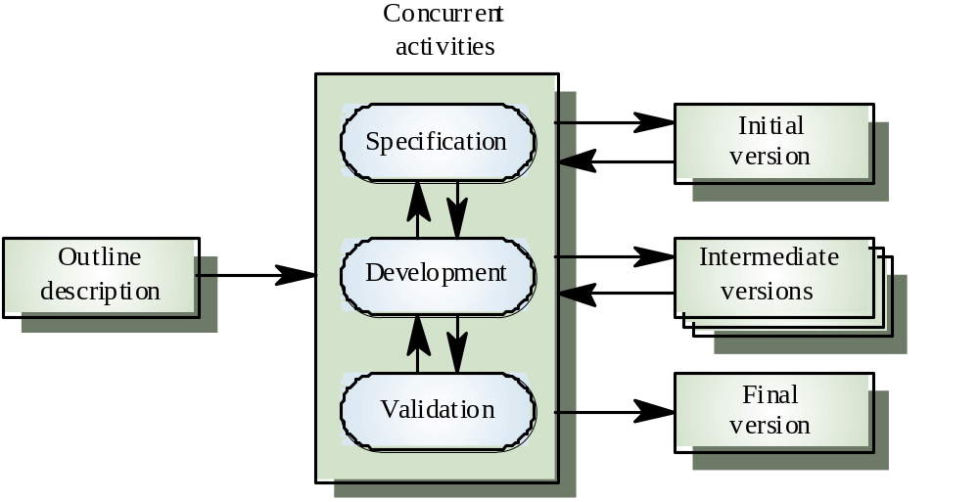
Evolutionary Process Model

Slide 38
Process Model Problems
Waterfall
  High risk for new systems because of specification and
  design problems.
  Low risk for well-understood developments using familiar
  technology.
Prototyping
  Low risk for new applications because specification and
  program stay in step.
  High risk because of lack of process visibility.
Transformational
  High risk because of need for advanced technology and
  staff skills.

Slide 39
Hybrid Process Models
Large systems are usually made up of several
sub-systems.
The same process model need not be used for
all subsystems.
Prototyping for high-risk specifications.
Waterfall model for well-understood
developments.

Slide 40
2. Code-and-Fix
This model starts with an informal general
product idea and just develops code until a
product is ”ready” (or money or time runs
out). Work is in random order.
Corresponds with no plan! (Hacking!)

Slide 41
Advantages
No administrative overhead
Signs of progress (code) early.
Low expertise, anyone can use it!
Useful for small “proof of concept” projects, e.g. as part of risk reduction.

Slide 42
Disadvantages
Dangerous!
  No visibility/control
  No resource planning
  No deadlines
  Mistakes hard to detect/correct
2. Impossible for large projects,
communication breakdown, chaos.

Slide 43
3. Spiral Model
Since end-user requirements are hard to
obtain/define, it is natural to develop software
in an experimental way: e.g.
Build some software
See if it meets customer requirements
If no goto 1 else stop.

Slide 44
This loop approach gives rise to structured
iterative lifecycle models.
In 1988 Boehm developed the spiral model as
an iterative model which includes risk
analysis and risk management.
Key idea: on each iteration identify and solve
the sub-problems with the highest risk.

Slide 45
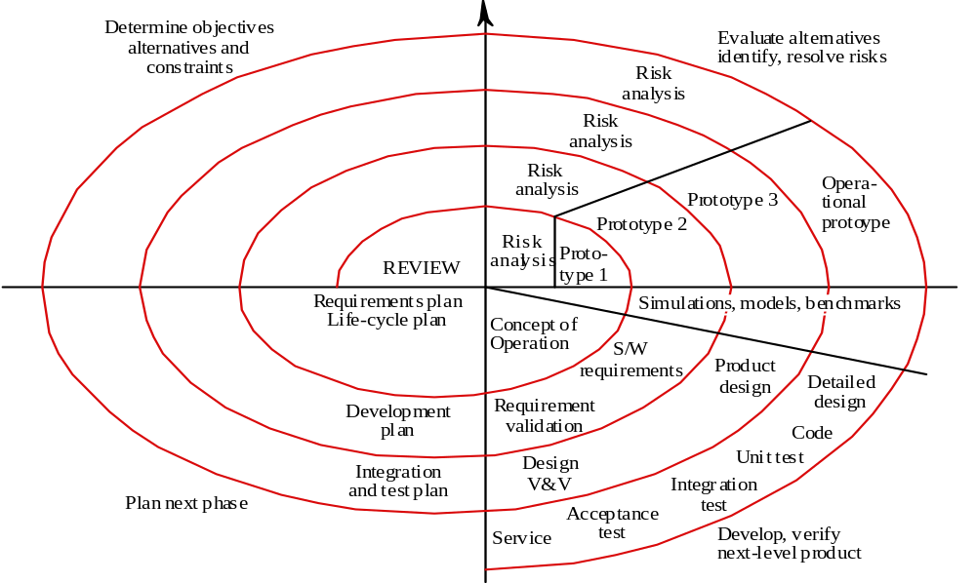
Spiral Process Model

Slide 46
Each cycle follows a waterfall model by:
Determining objectives
Specifying constraints
Generating alternatives
Identifying risks
Resolving risks
Developing next-level product
Planning next cycle

Slide 47
Advantages
Realism: the model accurately reflects the iterative nature of software development on projects with unclear requirements
Flexible: incoporates the advantages of the waterfal and rapid prototyping methods
Comprehensive model decreases risk
Good project visibility.

Slide 48
Disadvantages
Needs technical expertise in risk analysis to really work
Model is poorly understood by non-technical management, hence not so widely used
Complicated model, needs competent professional management. High administrative overhead.

Slide 49
4. Rapid Prototyping
Key idea: Customers are non-technical and
usually don’t know what they want/can have.
Rapid prototyping emphasises requirements
analysis and validation, also called:
customer oriented development,
evolutionary prototyping

Slide 50
Requirements Capture
Iterate
Quick Design
Build Prototype
Customer Evaluation of
Prototype
The Rapid
Prototype Workflow
Engineer Final
Product

Slide 51
Advantages
Reduces risk of incorrect user requirements
Good where requirements are changing/uncommitted
Regular visible progress aids management
Supports early product marketing

Slide 52
Disadvantages I
An unstable/badly implemented prototype often becomes the final product.
Requires extensive customer collaboration
  Costs customers money
  Needs committed customers
  Difficult to finish if customer withdraws
  May be too customer specific, no broad market

Slide 53
Disadvantages II
3. Difficult to know how long project will last
4. Easy to fall back into code-and-fix without proper requirements analysis, design, customer evaluation and feedback.

Slide 54
5. Agile (XP) Manifesto
XP = Extreme Programming emphasises:
Individuals and interactions
  Over processes and tools
Working software
  Over documentation
Customer collaboration
  Over contract negotiation
Responding to change
  Over following a plan

Slide 55
Agile Principles (Summary)
Continuous delivery of software
Continuous collaboration with customer
Continuous update according to changes
Value participants and their interaction
Simplicity in code, satisfy the spec

Slide 56
6. XP Practices (Summary)
Programming in pairs
Test driven development
Continuous planning, change , delivery
Shared project metaphors, coding standards and ownership of code
No overtime! (Yeah right!)

Slide 57
Advantages
Lightweight methods suit small-medium size projects
Produces good team cohesion
Emphasises final product
Iterative
Test based approach to requirements and quality assurance

Slide 58
Disadvantages
Difficult to scale up to large projects where documentation is essential
Needs experience and skill if not to degenerate into code-and-fix
Programming pairs is costly
Test case construction is a difficult and specialised skill.

Slide 59
7. Unified Process (UP)
Booch, Jacobson, Rumbaugh 1999.
Lifetime of a software product in cycles:
Birth, childhood, adulthood, old-age, death.
Product maturity stages
Each cycle has phases, culiminating in a new release (c.f. Spiral model)

Slide 60
Inception
Elaboration
Transition
Construction
UP Lifecycle – single phase workflow
(drawn as a UML Statechart!)

Slide 61
Inception – identify core use cases, and use to make architecture and design tradeoffs. Estimate and schedule project from derived knowledge.
Elaboration – capture detailed user requirements. Make detailed design, decide on build vs. buy.
Construction – components are bought or built, and integrated.
Transition – release a mature version that satisfies acceptance criteria.

Slide 62
Unified Process
Software Lifecycle
Product
Management
Environment
*
*
releases
Workflow
Cycle
Requirements
Inception
4
Design
Phase
Elaboration
Implementation
Construction
*
Assessment
Iteration
Transition
Deployment
*
Artifact

Slide 63
UML class diagram!
Use Case Model
specified by
realised by
Analysis Model
deployed by
implemented by
Design Model
verified by
Deployment Model
Implementation Model
All models are interdepedent
but this only shown for use
case model
Test Model

Slide 64
8. COTS
COTS =
Commercial Off-The-Shelf software
Engineer together a solution from existing commercial software packages using minimal software ”glue”.
E.g. using databases, spread sheets, word proccessors, graphics software, web browsers, etc.

Slide 65
Advantages
Fast, cheap solution
May give all the basic functionality
Well defined project, easy to run
Disadvantages
Limited functionality
Licensing problems, freeware, shareware, etc.
License fees, maintainance fees, upgrade
compatibility problems

Slide 66
Summary
Process Visibility
  Software systems are intangible so managers need documents to assess progress.
  Waterfall model is still the most widely used model.

Slide 67
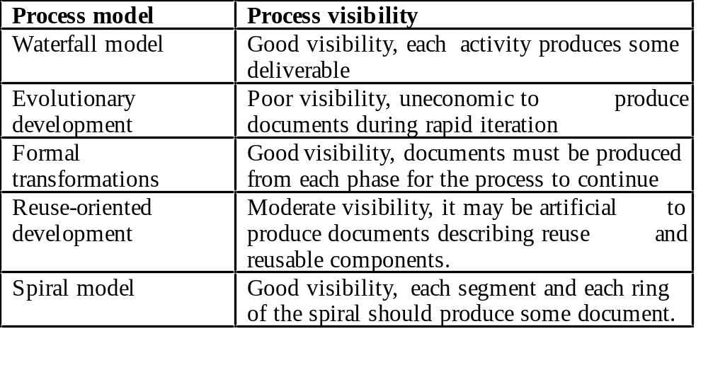
Process Model Visibility

